Slide 1
Capstone Project
Mobile Price Range Prediction
Classification
By
Ankur Nain

Slide 2
Problem statement
In the competitive mobile phone market companies want to understand sales data of mobile phones and Factors which drives the prices.
The objective is to find out some relation between features of a mobile phone and its selling price in this problem we do not have to predict theatrical process but a price range indicating how high the price is.

Slide 3
Point to discuss
Data description and summary
Exploratory data analysis
Heat map
Machine learning algorithms
Logistic regression
Decision tree
Random forest classifier
Xgboost classifier
5. conclusion.

Slide 4
Data description
The data contains information regarding mobile phone features,specification etc and their price range the various features and information can be used to predict the price range of a mobile phone .
Battery_power- Total energy a battery can store in one time measured in mAh.
Blue - has Bluetooth or not.
Clock_speed- speed at which microprocessor executes instructions.
Dual_sim- has dual sim support or not
Fc – front camera mega pixels
Four_g- has 4G or not
Int_memory- intern memory in Gigabytes
M_dep- mobile depth in cm
Mobile_wt – weight of mobile phone

Slide 5
Data description
N_cores – Number of cores of processor.
Pc – primary camera mega pixels.
Px_height – Pixels resolution height.
Px_weight – pixels resolution width.
Ram – random Access Memory in Mega Bytes.
Sc_h – Screen height of mobile in cm.
Talk_time – longest time that a single battery charge will when you are
Three_g – Has 3G or not .
Touch_screen – Has touch screen or not .
Wifi – has wifi or not
Price_range – this is the target varible with values of 0(low cost),1(medium cost),
2(high cost) and 3 (very high cost).

Slide 6
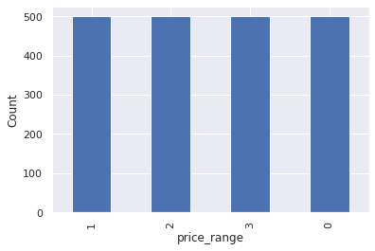
Exploratory Data Analysis
Price
There are mobile phones in 4 price ranges the number of elements is almost similar.

Slide 7
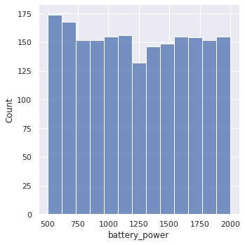
Battery
this plot shows how the battery mAh is spread. there is a gradual increase as the price range increases

Slide 8
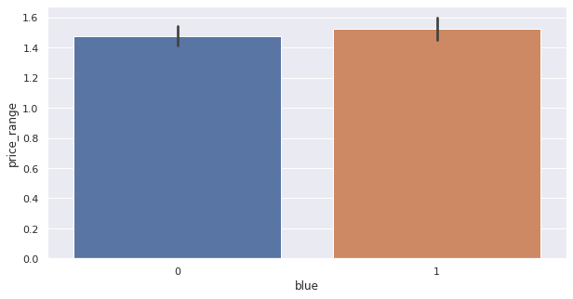
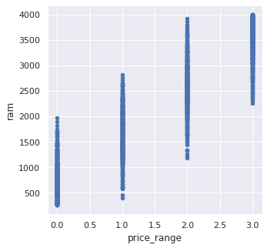
Bluetooth
Ram
Ram has continuous increase with price range while moving from Low cost to Very high cost
half the devices have Bluetooth, and half don’t.

Slide 9
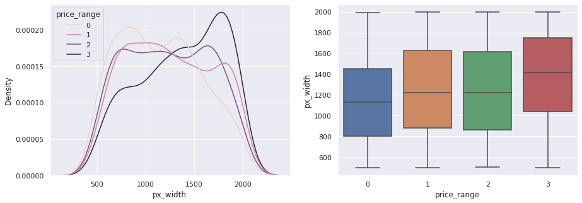
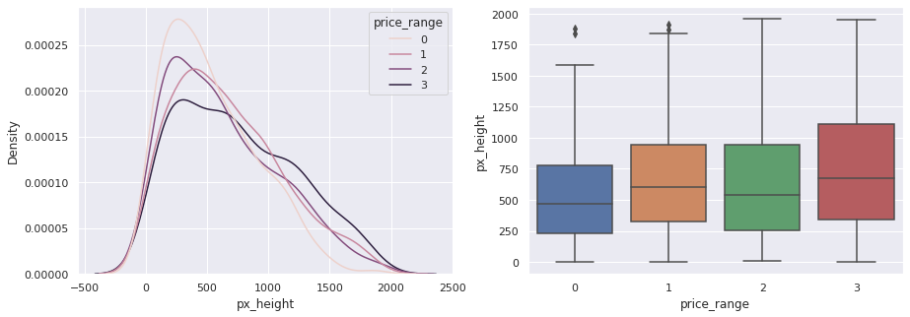
Px_width
PX_height
There is not a continuous increase in pixel width as we move from Low cost to Very high cost. Mobiles with 'Medium cost' and 'High cost' has almost equal pixel width. so we can say that it would be a driving factor in deciding price_range
Pixel height is almost similar as we move from Low cost to Very high cost.little variation in pixel_height

Slide 10
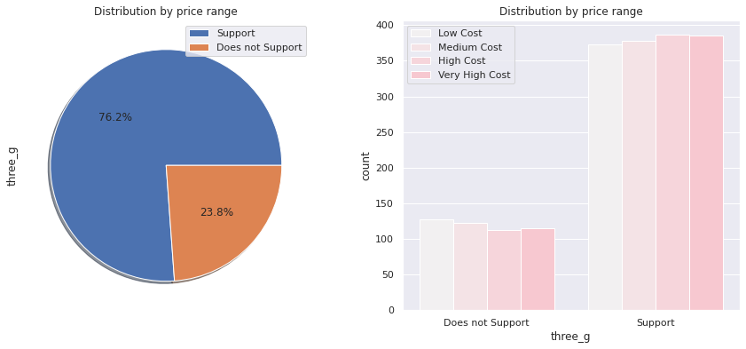
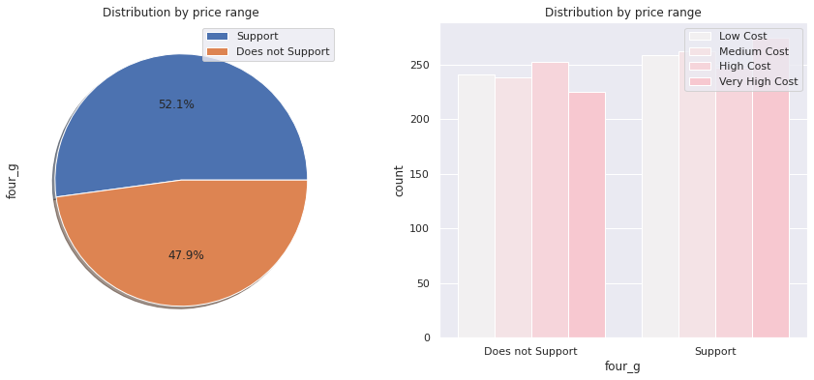
4G and 3G
52.1% of the phones support 4G and 76.2% of phones support 3_G features ‘three_g’play an important feature in prediction.

Slide 11
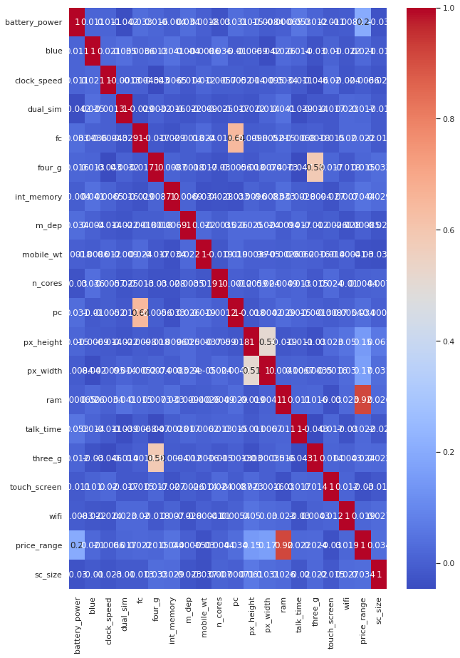
Heat Map
RAM and price_range shows high correlation which is a good sign, it signifies that RAM will play major deciding factor in estimating the price range.
There is some collinearity in feature pairs ('pc', 'fc') and ('px_width', 'px_height'). Both correlations are justified since there are good chances that if front camera of a phone is good, the back camera would also be good.
Also, if px_height increases, pixel width also increases, that means the overall pixels in the screen. We can replace these two features with one feature. Front Camera megapixels and Primary camera megapixels are different entities despite of showing colinearity. So we'll be keeping them as they are

Slide 12
ML Algorithms
Logistic regression.
Decision tree.
Random forest classification.
XGboost.

Slide 13
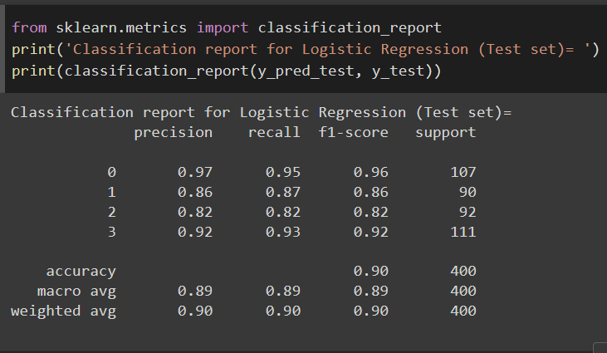
Logistic regression
Train_accuracy: 92%
Test_accuracy: 90%

Slide 14
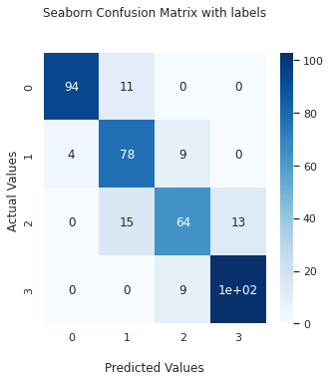
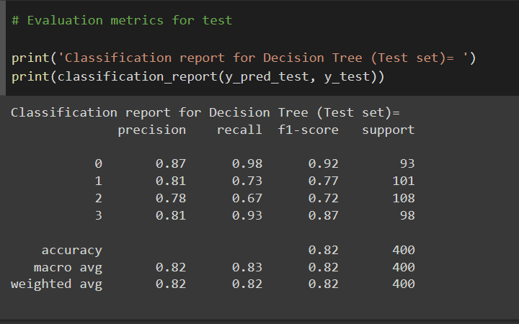
Decision tree with Hypermeter tuning
Test_accuracy : 82%

Slide 15
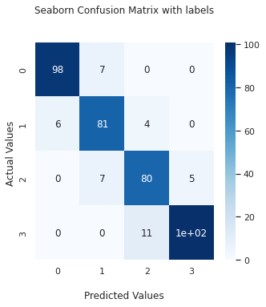
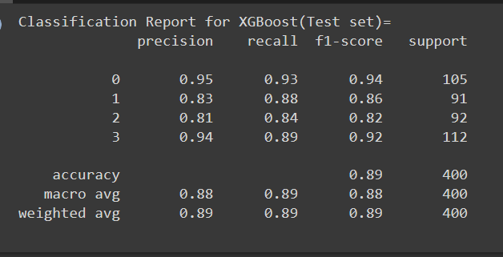
XGboost with hyperparameter tunning
Test _accuracy: 89%

Slide 16
Conclusion
from EDA we can see that here are mobile phones in 4 price ranges. the number of element is almost similar.
half the device have Bluetooth and half don't.
costly phones are lighter.
RAM battery power ,pixels played more sighnification role in deciding the price range of mobile phone.
form all the above experiment we can conclude that logistic regression and XGbosting with using hyperparameters we got the best results.
The accuracy and performance of the model is evaluated by using confusion matrix

